Slide 1


















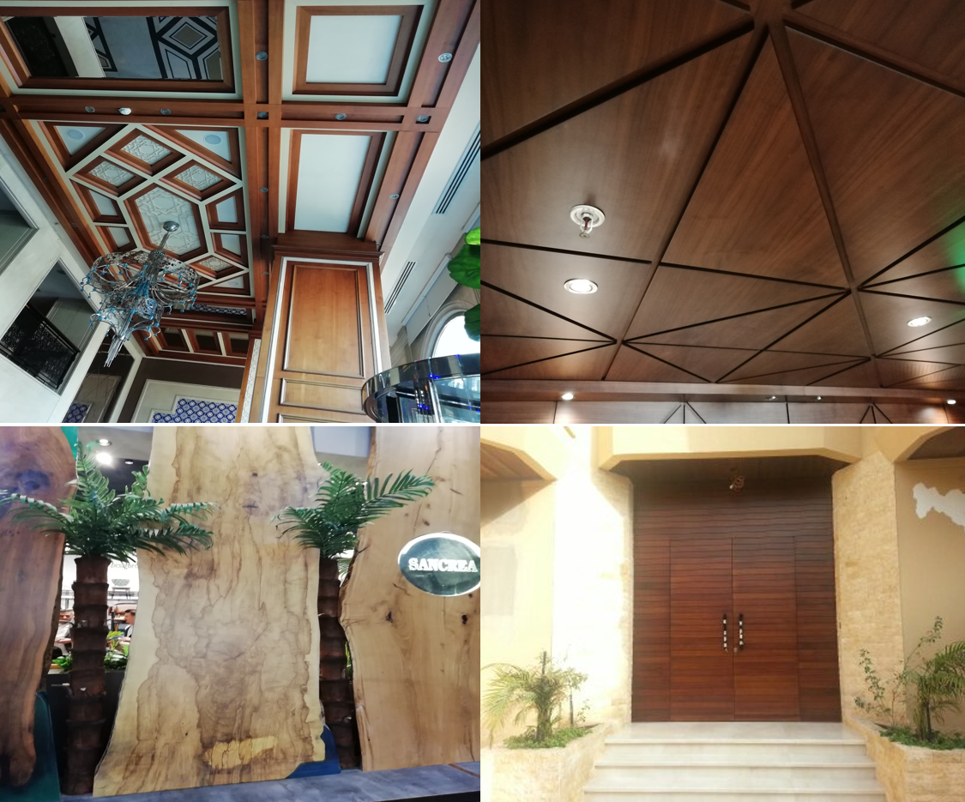
Best Selection For Trading

Slide 2
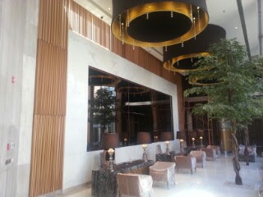
Best Selection For Trading
INTRODUCTION
Best Selection is a specialized company that manufactures all kinds of woodwork and has 5 years of experience in the field of carpentry, design, showrooms, kitchens, wall cladding, wardrobe, hotel room furnishing requirements, restaurants, and shops. The scope of work also includes interior and exterior wood decoration, remodeling, and adding new decorations to buildings
The company has gained a prominent position in the field of woodwork, as the company does not depend on the local market only, but rather imports wood according to the customer's desire, such as kitchens, wardrobes, doors, offices, and other works
Whatever the size of the project you want to accomplish, the best selections will give you distinct services according to your needs, as it always focuses on the quality of its performance and achieving the full satisfaction of its customers.
Best Selection Company

Slide 3

Best Selection For Trading
OUR VISION
What Makes Best Selection Different ?
When the company was established in 2017, the management resolved to provide a work approach based on credibility, dedication and complete sincerity in the completion of any project that falls on the company's shoulders. Since then, this principle has been a cornerstone that embodies the long-established values of dealing with customers. Whether the project we are implementing is a huge complex or just simple decoration works, the best selections will do their utmost to meet all your requirements as they are working hard to be your first destination for your next projects.

Slide 4
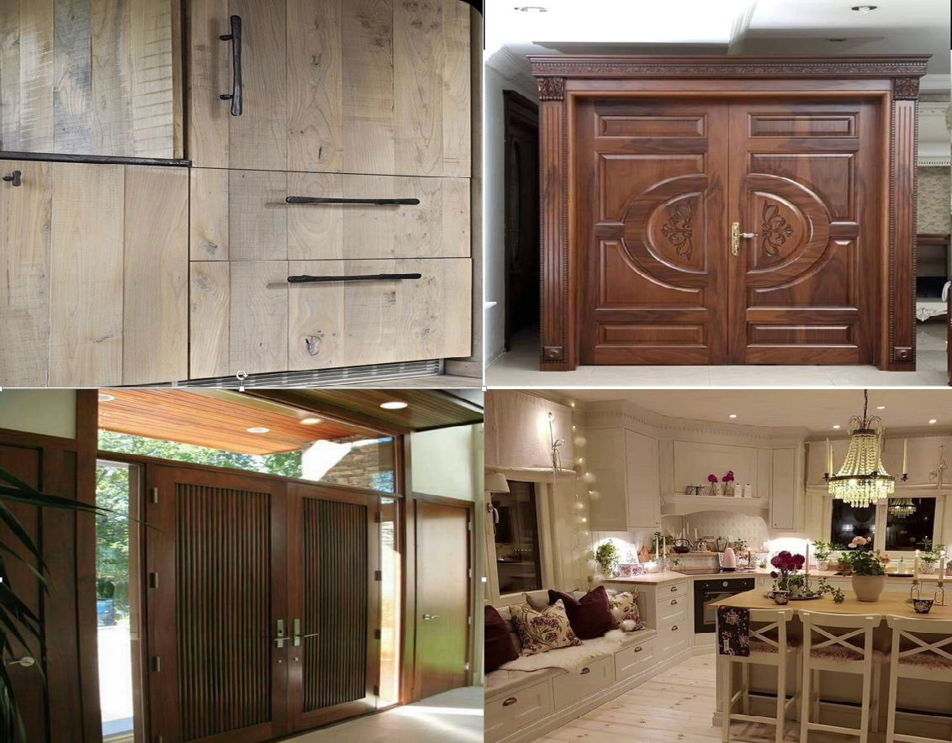
Best Selection For Trading
PROJECT | PROJECT DESCRIPTION
The Saudi village of al Basateen [8] | Location | Jeddah - KSA
 | Year | 2005-2009
 | Scope of Work | Doors - Kitchens - Cupboards
Sheikh Mohammed Al Zabin Villas Group | Location | Jaddah - KSA
 | Year | 2005
 | Scope of Work | Doors - Kitchens
Dr. Abbas Serfi hospital | Location | Makkah - KSA
 | Year | 2005
 | Scope of Work | Artificial marble surfaces - Laundries - laboratories - kitchens
Al-Burj Laboratories | Location | Jeddah - KSA
 | Year | 2005
 | Scope of Work | Laboratory surfaces and cabins

Slide 5
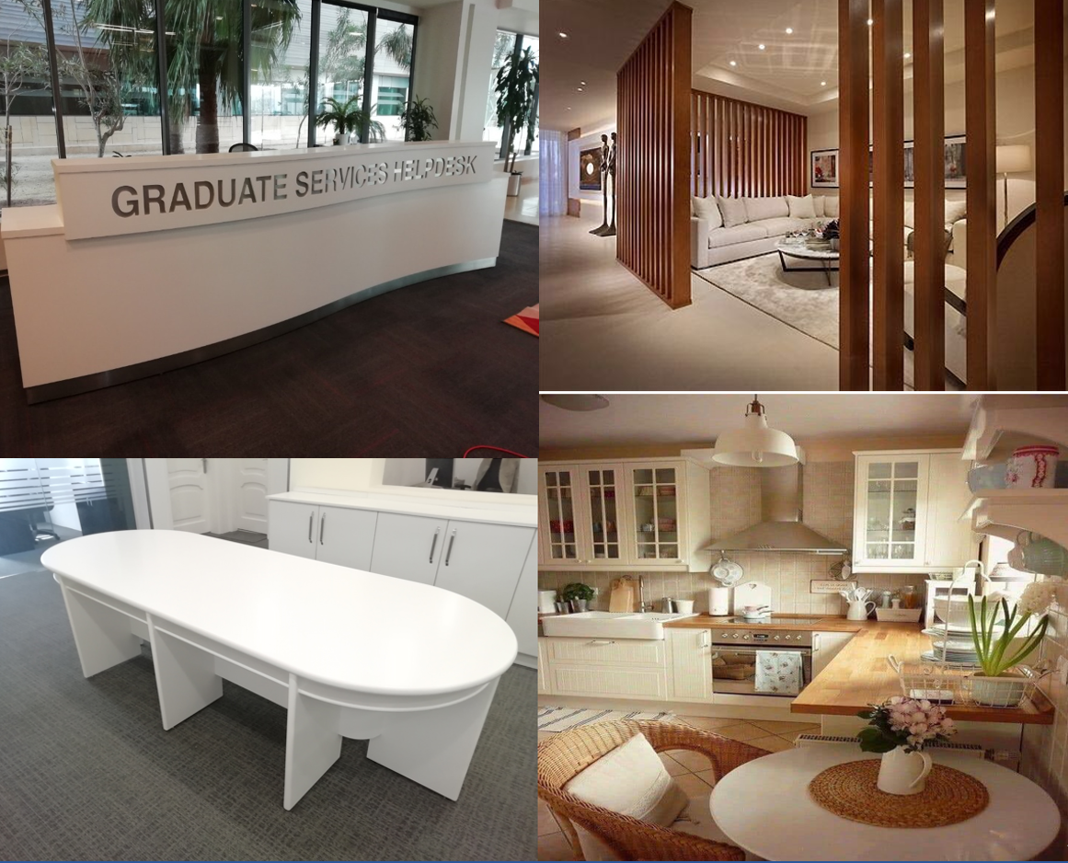
Best Selection For Trading
PROJECT | PROJECT DESCRIPTION
Al-Issa resort, Abar | Location | Jeddah - KSA
 | Year | 2005
 | Scope of Work | Kitchens and wooden decorations
Royal commission for Jubail and Yanbu complex 4G-2G | Location | Yanbu - KSA
 | Year | 2005
 | Scope of Work | interior decorations
Al Shorouk complex | Location | Al-Riyadh - KSA
 | Year | 2005
 | Scope of Work | Subcontractor - Wood Works
Ministry of Hajj | Location | Makkah - KSA
 | Year | 2005-2006
 | Scope of Work | Office cabins and interiors

Slide 6
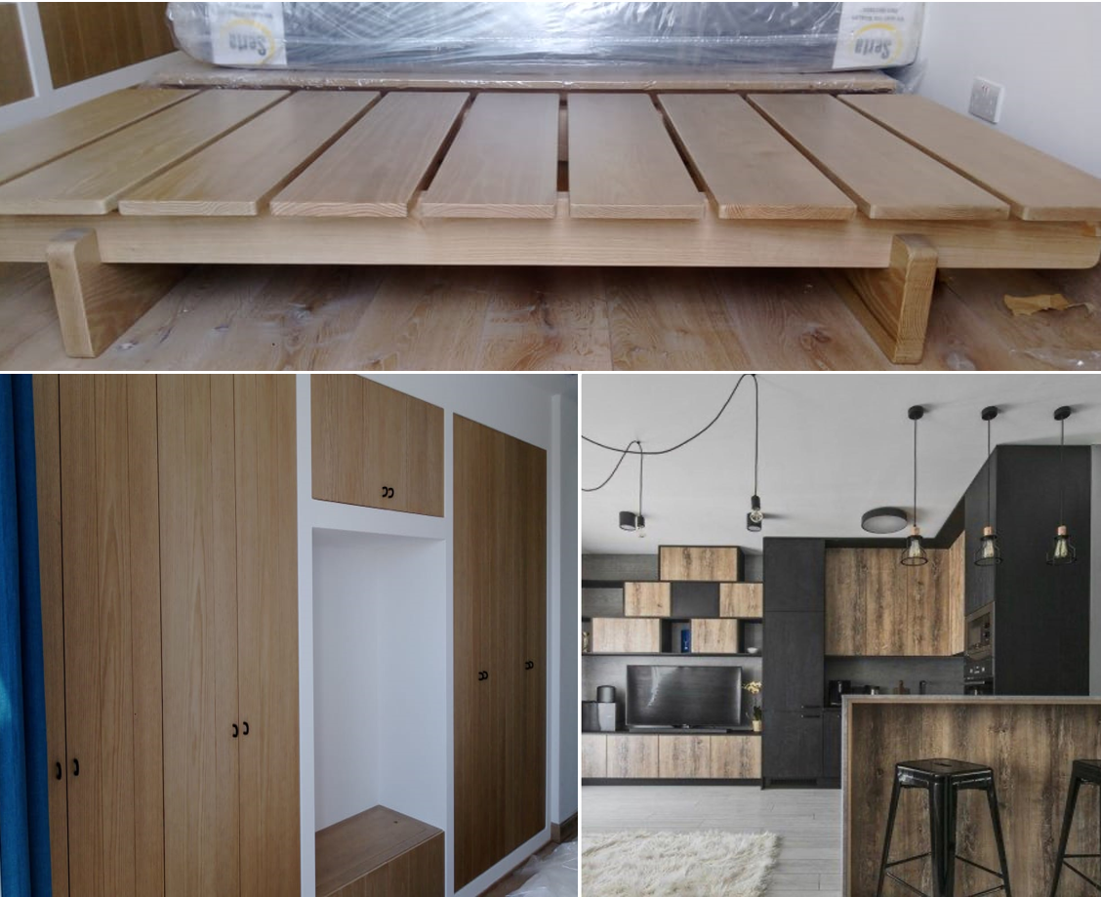
Best Selection For Trading
PROJECT | PROJECT DESCRIPTION
Meridian Makkah - Saudi Ogeh | Location | Makkah - KSA
 | Year | 2006
 | Scope of Work | Subcontractor - Doors
Bin Hamran Al Tahlia Center | Location | Jeddah - KSA
 | Year | 2006
 | Scope of Work | Kitchens - Interiors
Nada village | Location | Jeddah - KSA
 | Year | 2006
 | Scope of Work | Kitchens
Makkah Hilton Towers Hotel | Location | Makkah - KSA
 | Year | 2006-2007
 | Scope of Work | Room Furniture - Doors - Interior Decorations

Slide 7
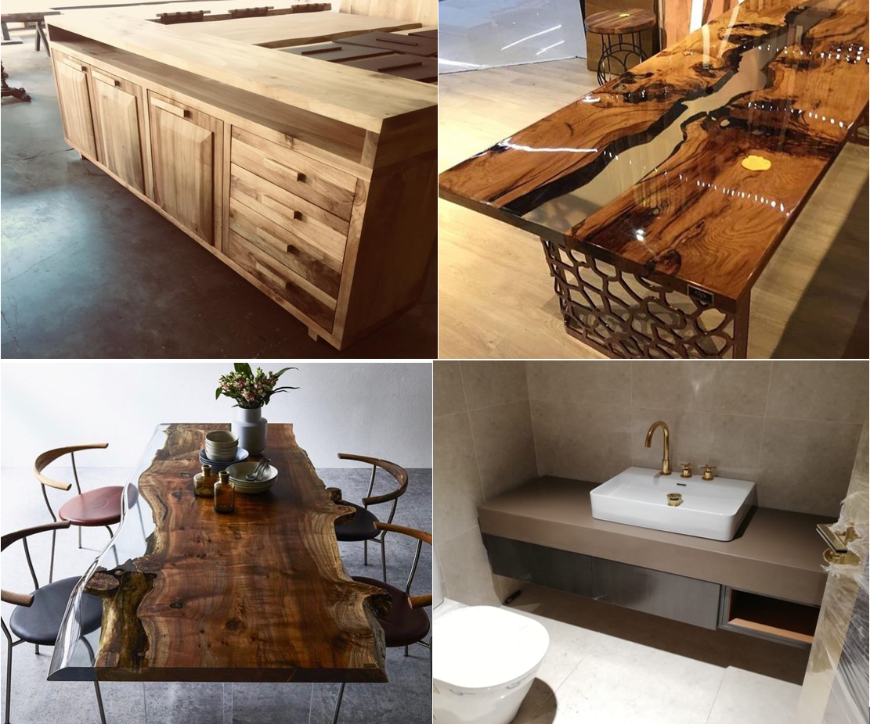
Best Selection For Trading
PROJECT | PROJECT DESCRIPTION
Enaya Center | Location | Jeddah – KSA
 | Year | 2006
 | Scope of Work | Artificial marble countertops- Laundries
Religious center plaza | Location | Jeddah – KSA
 | Year | 2006
 | Scope of Work | kitchens
Dr. Darwish Zagzouk Hospital | Location | Jeddah – KSA
 | Year | 2007
 | Scope of Work | Kitchens - Interiors – Doors
Al Qibleteen hotel | Location | Al-Madinah Almnawarah – KSA
 | Year | 2007
 | Scope of Work | Kitchens – Doors - wardrobe doors

Slide 8
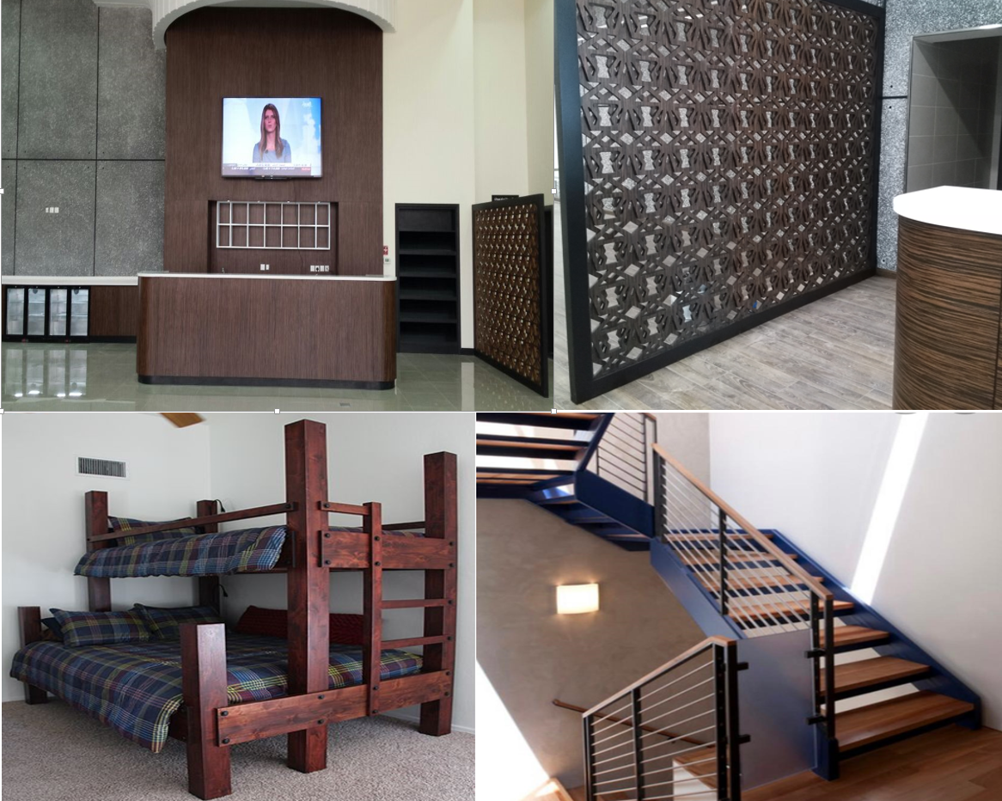
Best Selection For Trading
PROJECT | PROJECT DESCRIPTION
Saudi Arabian Airlines Air Operations | Location | Jeddah – KSA
 | Year | 2007
 | Scope of Work | Interior Decorations
Paris gallery- Al-Andalus Mall | Location | Jeddah – KSA
 | Year | 2007
 | Scope of Work | kitchens - Interior Decorations
Saudi Arabian Airlines old airport | Location | Jeddah – KSA
 | Year | 2007
 | Scope of Work | Interior Decorations - Interior Design – Furniture
Bright stars school | Location | Jeddah – KSA
 | Year | 2007
 | Scope of Work | Interior decorations – Office Cabinets

Slide 9
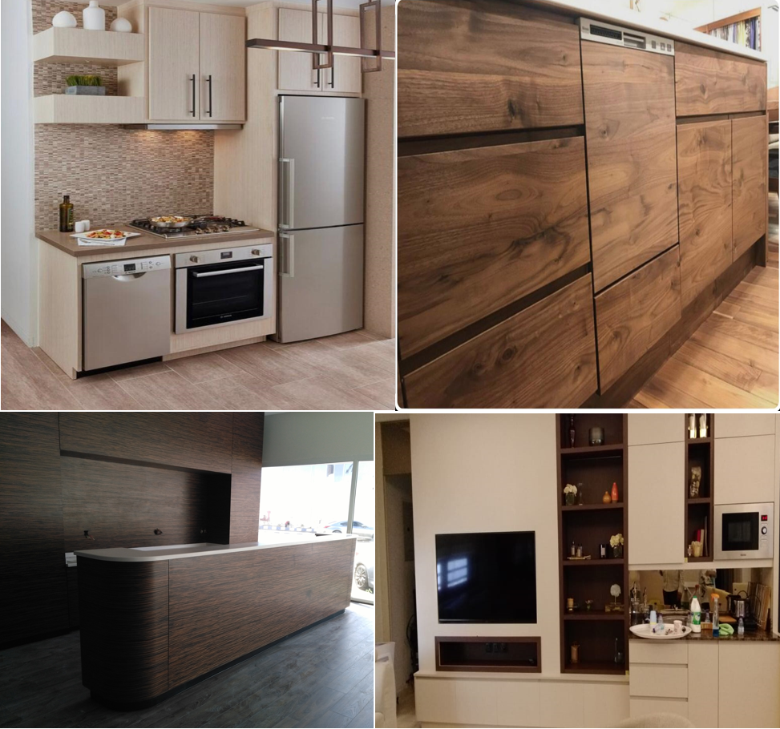
Best Selection For Trading
PROJECT | PROJECT DESCRIPTION
Borouj Al Marwa | Location | Makkah - KSA
 | Year | 2007
 | Scope of Work | Hotel furniture - interior decorations - reception counters
Holiday Inn hotel | Location | Jeddah - KSA
 | Year | 2007
 | Scope of Work | Interior decorations
Coral compound | Location | Jeddah - KSA
 | Year | 2008
 | Scope of Work | Kitchens
Taraf hotel apartments | Location | Yanbu – KSA
 | Year | 2008
 | Scope of Work | Room furniture - doors - interior decorations - reception counters - kitchens

Slide 10
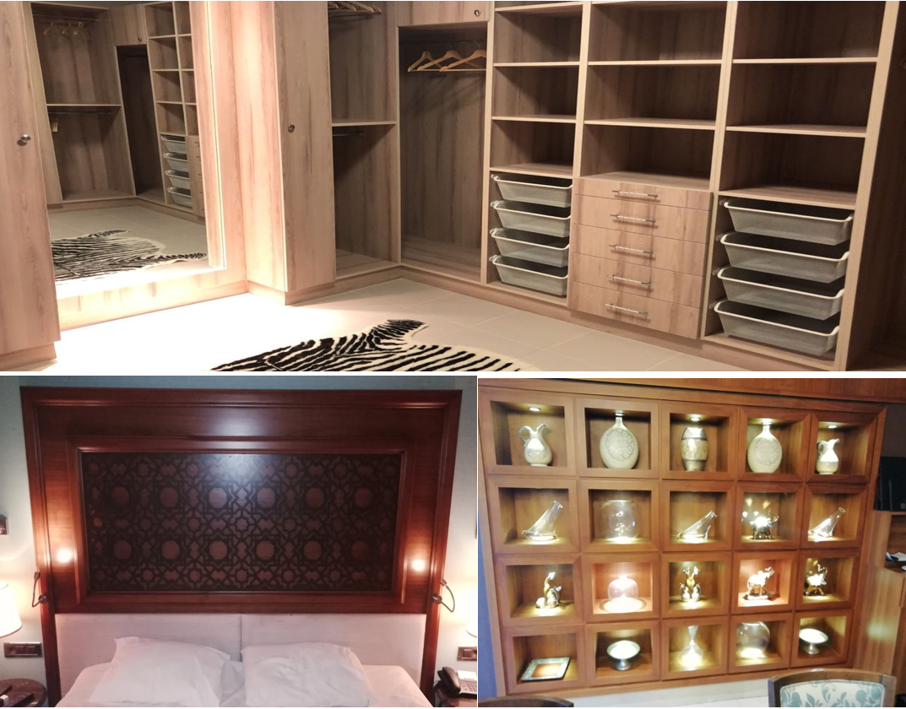
Best Selection For Trading
PROJECT | PROJECT DESCRIPTION
Crown Plaza Hotel | Location | Jeddah - KSA
 | Year | 2007-2008
 | Scope of Work | Doors - hotel room furniture - interior decorations - dining tables
Al Ahlia cement factory | Location | Jeddah - KSA
 | Year | 2009
 | Scope of Work | Interior decorations - doors - office cupboards
Coral School | Location | Jeddah - KSA
 | Year | 2009
 | Scope of Work | Archive rooms - office safes
Bin Mahfouz Villas complex | Location | Jeddah – KSA
 | Year | 2009
 | Scope of Work | Wardrobes - Kitchens

Slide 11
Best Selection For Trading
PROJECT | PROJECT DESCRIPTION
Crown Plaza Hotel | Location | Jeddah - KSA
 | Year | 2007-2008
 | Scope of Work | Doors - hotel room furniture - interior decorations - dining tables
Al Ahlia cement factory | Location | Jeddah - KSA
 | Year | 2009
 | Scope of Work | Interior decorations - doors - office cupboards
Coral School | Location | Jeddah - KSA
 | Year | 2009
 | Scope of Work | Archive rooms - office safes
Bin Mahfouz Villas complex | Location | Jeddah – KSA
 | Year | 2009
 | Scope of Work | Wardrobes - Kitchens

Slide 12
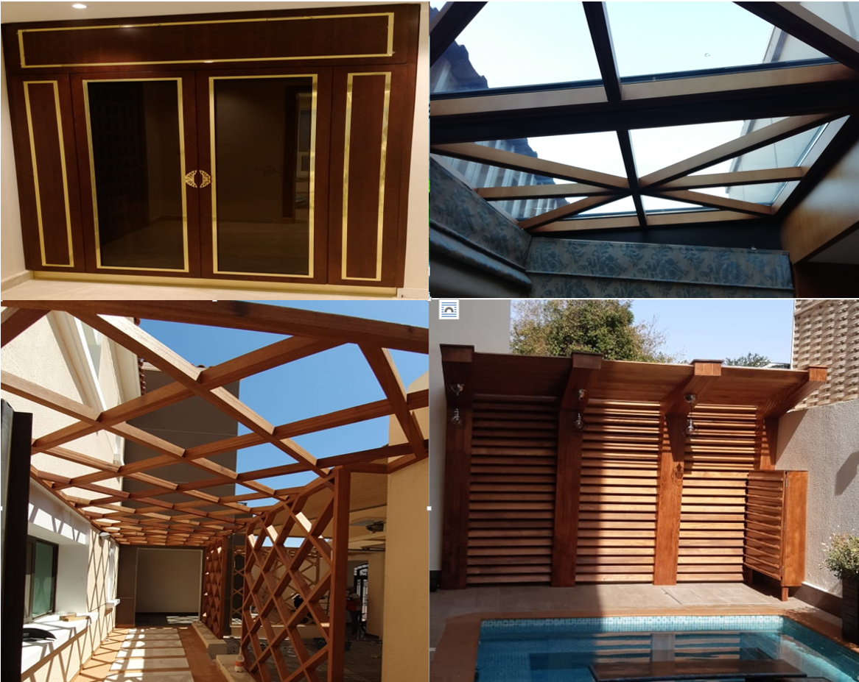
Best Selection For Trading
PROJECT | PROJECT DESCRIPTION
Offices of the General Administration of the Dar Alhandasah | Location | Jeddah - KSA
 | Year | 2009-2011
 | Scope of Work | Hotel room furniture - office cabins - kitchens - offices - wooden ceilings - interior decorations - doors.
King Abdulaziz Hospital | Location | Jeddah - KSA
 | Year | 2009
 | Scope of Work | Office cabins - doors - wooden partitions - interior decorations - reception counters
Al Jawhara hotel | Location | Jeddah - KSA
 | Year | 2010
 | Scope of Work | Tables - Doors - Umbrellas - Interior Decorations
Dr. Ghassan Phoraon hospital | Location | Jeddah – KSA
 | Year | 2010
 | Scope of Work | Clinic cabins-laboratory surfaces

Slide 13
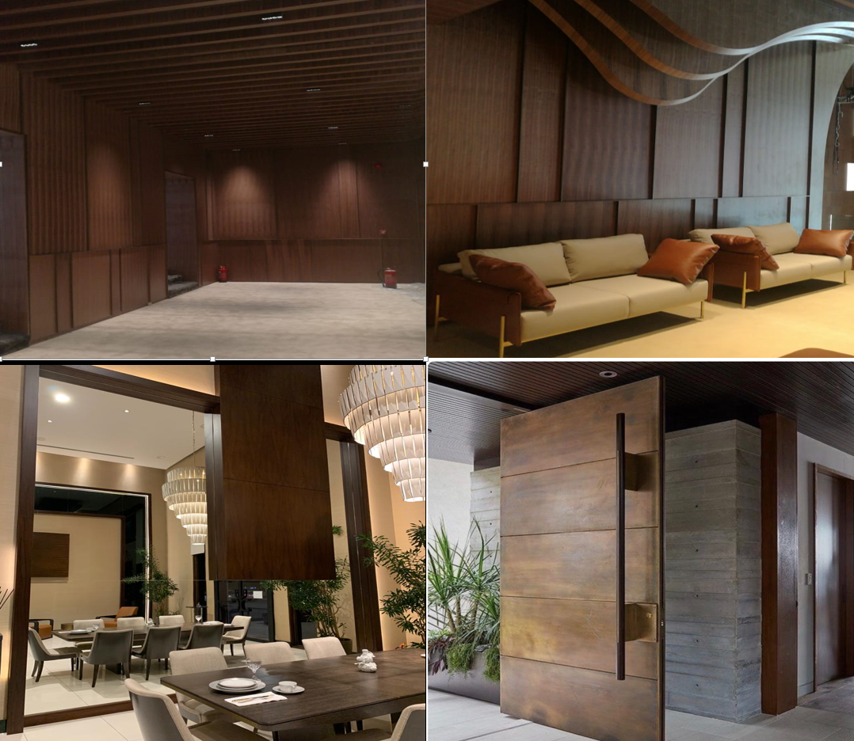
Best Selection For Trading
PROJECT | PROJECT DESCRIPTION
Jeddah Westin Hotel & Suites | Location | Jeddah - KSA
 | Year | 2010-2013
 | Scope of Work | Wall covering - interior decoration - hotel room furniture
Dr. Suleiman Fakih hospital | Location | Jeddah - KSA
 | Year | 2011-2012
 | Scope of Work | Wardrobe - doors - kitchens
Dar Al Qibla hotel | Location | Al-Madinah Almnawarah - KSA
 | Year | 2011-2013
 | Scope of Work | Wardrobes - Hotel Furniture
Sheraton Hotel project | Location | Jeddah – KSA
 | Year | 2013
 | Scope of Work | Wooden decoration works in the main entrance - interior decorations

Slide 14
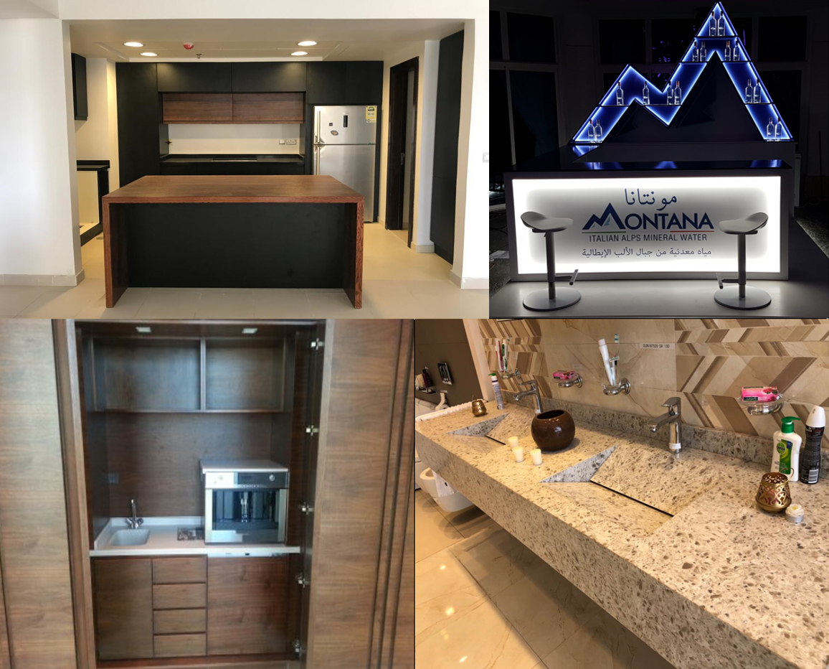
Best Selection For Trading
PROJECT | PROJECT DESCRIPTION
Hyundai Al-Madinah project (1S) | Location | Al-Madinah Almnawarah - KSA
 | Year | 2013
 | Scope of Work | All woodwork (doors - Laundries - kitchens..)
Hyundai Al-Madinah Hejrah Project-3S | Location | Al-Madinah Almnawarah - KSA
 | Year | 2013
 | Scope of Work | All woodwork (doors - Laundries - kitchens..)
Hyundai Al-Bassami Project-3S | Location | Jeddah – KSA - KAUST
 | Year | 2013
 | Scope of Work | All woodwork (doors - Laundries - kitchens..)
Saudi Electricity Company | Location | Jeddah – KSA
 | Year | 2014
 | Scope of Work | Display tables - counters

Slide 15
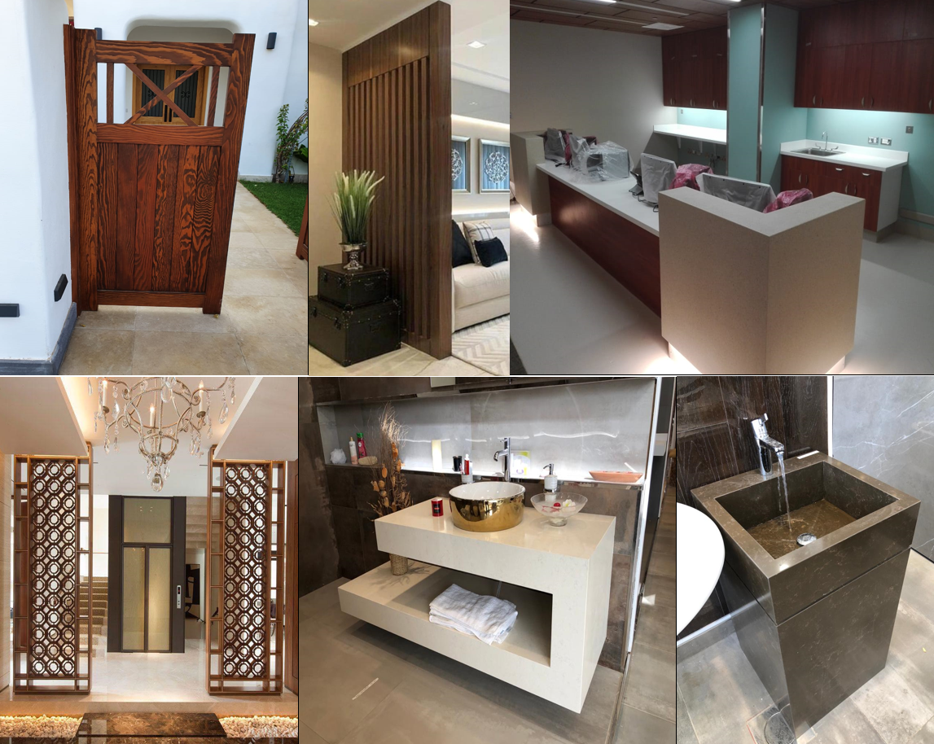
Best Selection For Trading
PROJECT | PROJECT DESCRIPTION
Lexus Al-Madinah Road | Location | Jeddah - KSA
 | Year | 2014
 | Scope of Work | Interior decorations - reception counters - wall cabins - buffet - wooden partitions - artificial marble countertops with Laundries
Al Jawhara stadium | Location | Jeddah – KSA
 | Year | 2015
 | Scope of Work | Interior decorations
KAUST | Location | Jeddah – KSA - KAUST
 | Year | 2015
 | Scope of Work | Interior decorations - doors - wall coverings - reception counters - kitchens
Al-Sherbetli village | Location | Jeddah – KSA
 | Year | 2015
 | Scope of Work | kitchens

Slide 16
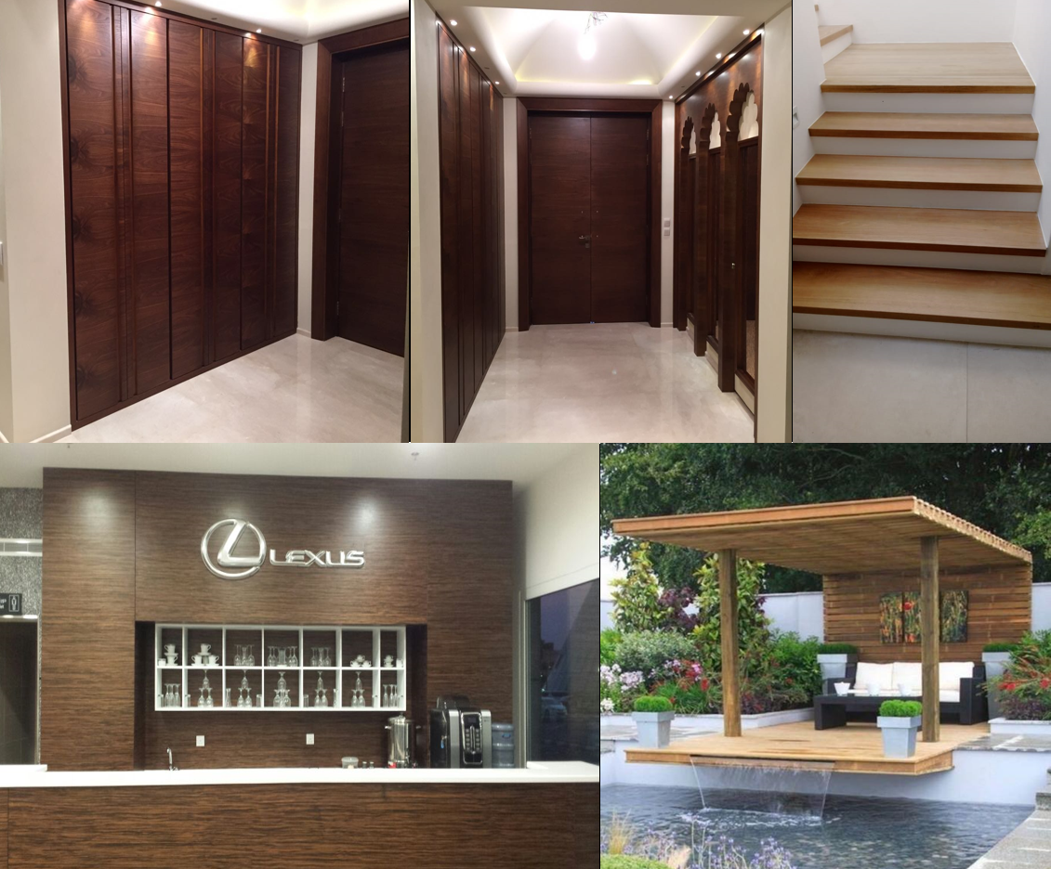
Best Selection For Trading
PROJECT | PROJECT DESCRIPTION
Dr. Samir Abbas hospital | Location | Jeddah - KSA
 | Year | 2016 up to 2018
 | Scope of Work | Reception desks - artificial marble surfaces - fireproof doors - beauty center - internal and external pharmacy
Lexus of Al-Amal street | Location | Jeddah – KSA – Al-Amal Street
 | Year | 2016
 | Scope of Work | Interior decorations - reception counters - wall cabins - buffet - wooden partitions - artificial marble countertops with Laundries
SABIC project | Location | Jeddah – KSA - KAUST
 | Year | 2016
 | Scope of Work | Interior decorations - doors - wall coverings - reception counter
SABIC project | Location | Jeddah – KSA - KAUST
 | Year | 2016
 | Scope of Work | Interior decorations - doors - wall coverings - reception counter

Slide 17
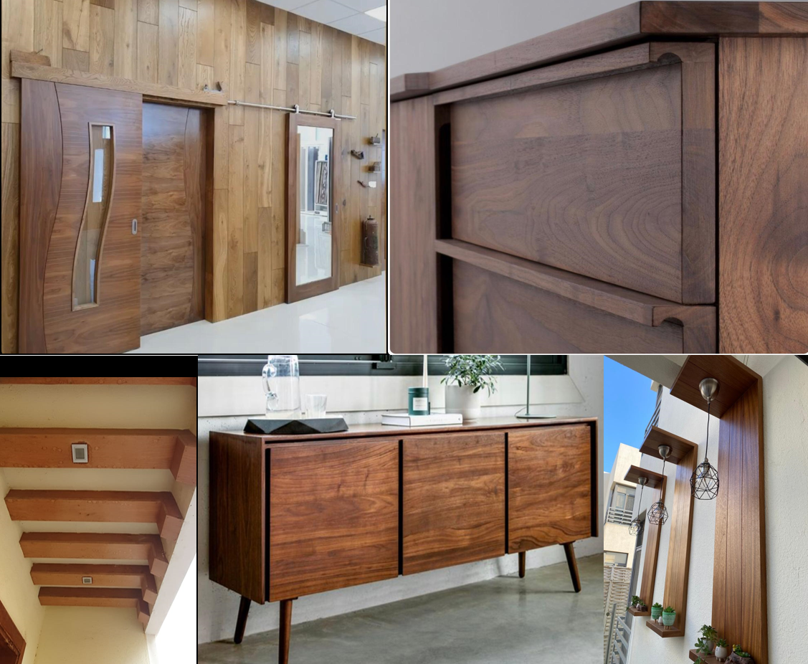
Best Selection For Trading
PROJECT | PROJECT DESCRIPTION
Taraf -2- | Location | Yanbu
 | Year | 2017
 | Scope of Work | Interior decorations - hotel furniture - reception counters
Al-Amal Hospital | Location | Yanbu
 | Year | 2017
 | Scope of Work | Reception counters - parquet - doors - laboratory cabins - handrails
Saudi consult | Location | Jeddah - KSA
 | Year | 2018
 | Scope of Work | Kitchens
Ismail Abu Dawood company | Location | Jeddah - KSA
 | Year | 2018-2019
 | Scope of Work | Interior decorations - kitchens - doors

Slide 18
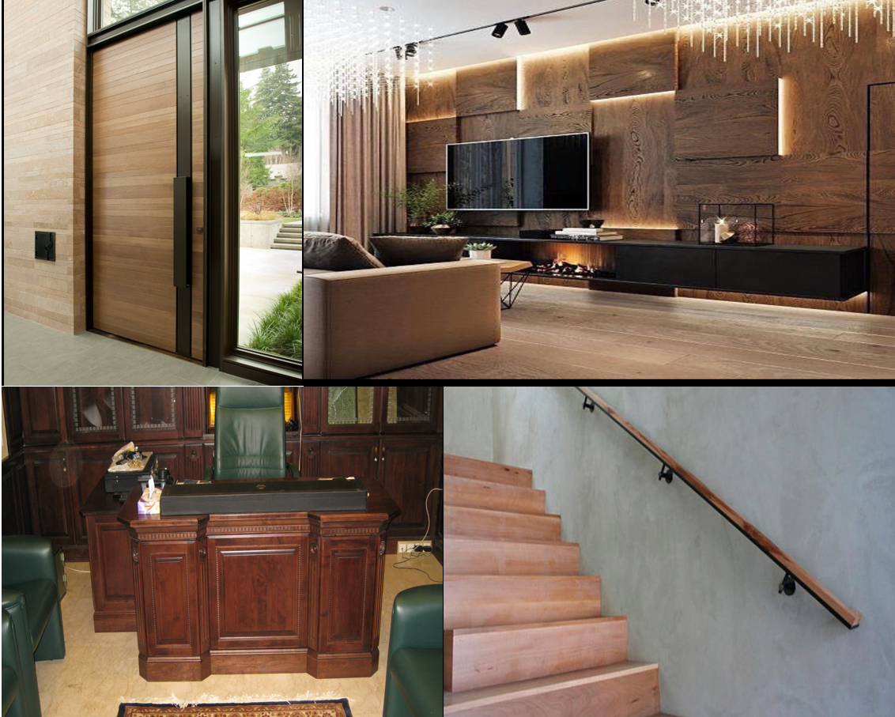
Best Selection For Trading
PROJECT | PROJECT DESCRIPTION
Royal Commission Mosques | Location | Yanbu
 | Year | 2018
 | Scope of Work | Sheathing walls - pulpit - wooden balustrade - interior decorations
KAUST | Location | Jeddah
 | Year | 2019
 | Scope of Work | Reception counters
Montana water company | Location | Jeddah
 | Year | 2019
 | Scope of Work | Display counters
Beach district Villas complex | Location | Jeddah
 | Year | 2019
 | Scope of Work | Doors

Slide 19
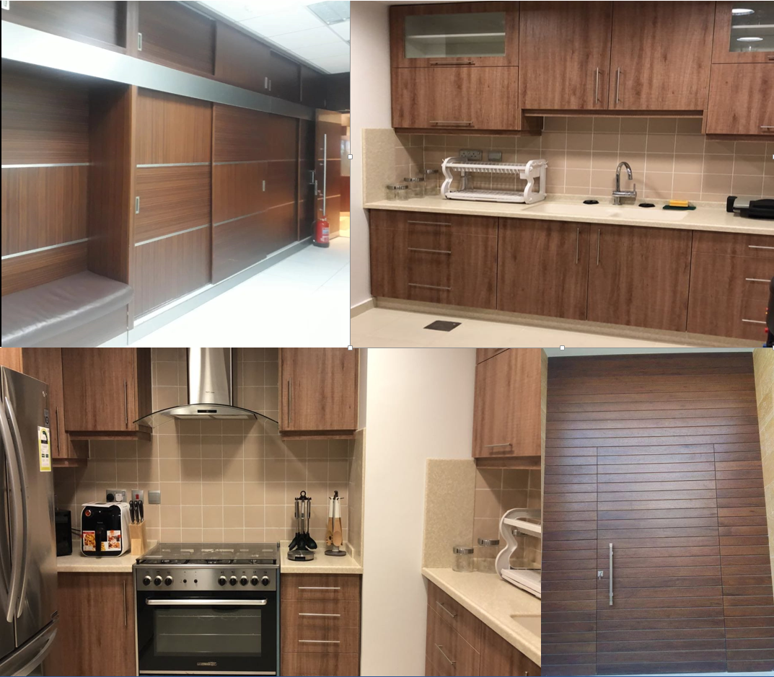
Best Selection For Trading
PROJECT | PROJECT DESCRIPTION
Yanbu Industrial | Location | Yanbu
 | Year | Joint works
 | Scope of Work | Shades
Aramco | Location | Yanbu
 | Year | Joint works
 | Scope of Work | Laundries - artificial marble countertops - meeting room
Samref | Location | Yanbu
 | Year | Joint works
 | Scope of Work | Doors-kitchens - wardrobes - handrails
Yanbu | Location | Yanbu
 | Year | Joint works
 | Scope of Work | Villa Shades

Slide 20
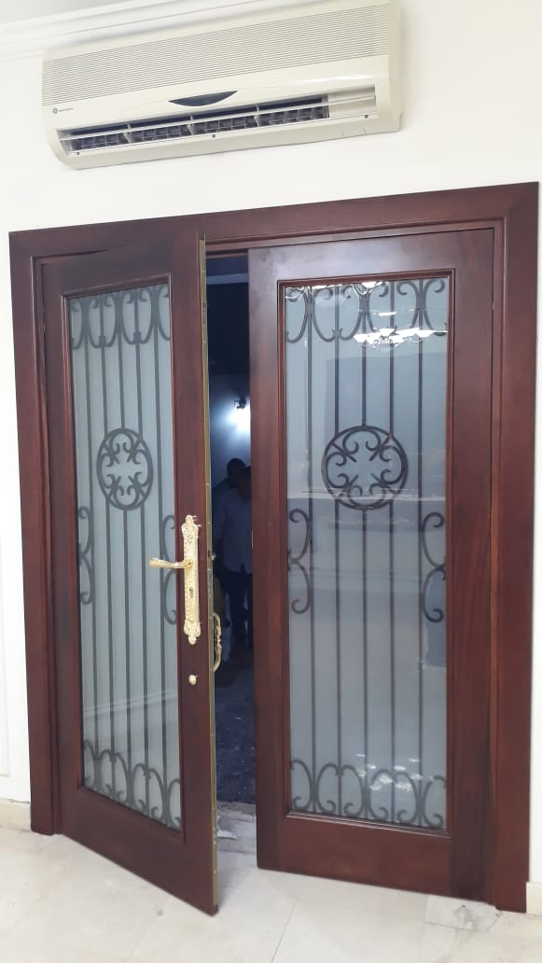
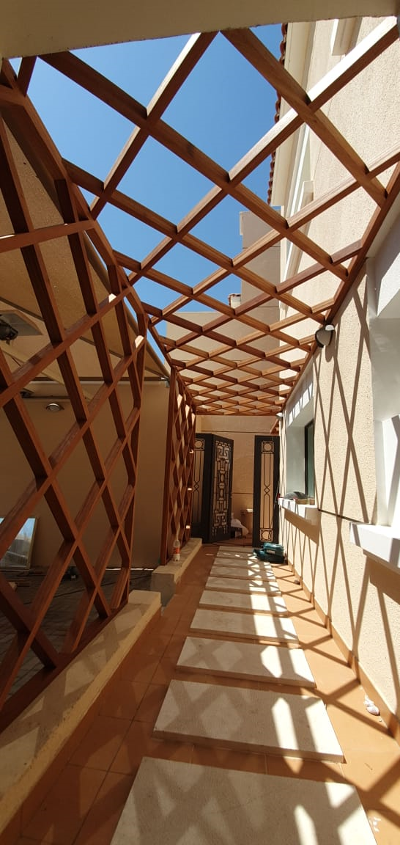
Best Selection For Trading
PROJECT | PROJECT DESCRIPTION
Mohammad Abduullah Hashim Villas | Location | Jeddah
 | Year | 2020
 | Scope of Work | Kitchen Cabinets/Wordrobe / Doors / Pergola /Vanities/ Beds/ Pools wooden flooring
Ismael Abu dawood Offices | Location | Jeddah
 | Year | 2020
 | Scope of Work | Doors/ wardrobe / offices / File Cabinets
King Abdullaziz university | Location | Jeddah
 | Year | 2020
 | Scope of Work | Pergola / Doors
KAEC | Location | Thwal
 | Year | 2020
 | Scope of Work | Pergola / Doors / Wooden Cladding

Slide 21
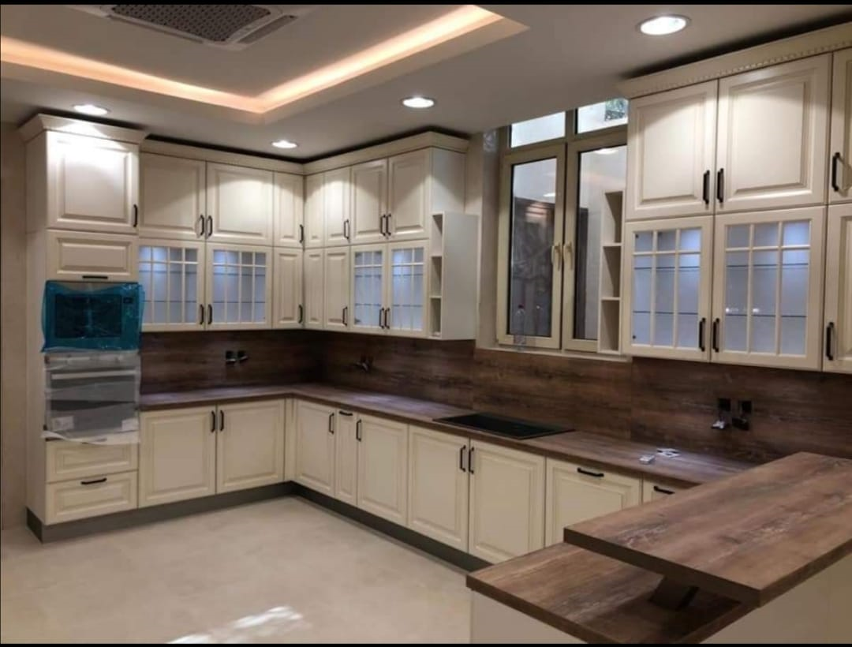
Best Selection For Trading
PROJECT | PROJECT DESCRIPTION
KAUST | Location | Thwal
 | Year | 2020
 | Scope of Work | Kitchen Cabinets/ Doors / Vanities
Harbor | Location | Thwal
 | Year | 2020
 | Scope of Work | Doors/File Cabinets/ offices /Wooden ceiling / Vanities
Al Salam Palace | Location | Jeddah
 | Year | 2021
 | Scope of Work | Kitchens / Wooden ceiling / Wall Cladding
Host Market | Location | Jeddah
 | Year | 2021
 | Scope of Work | Wooden Shelves / Counter / Doors

Slide 22
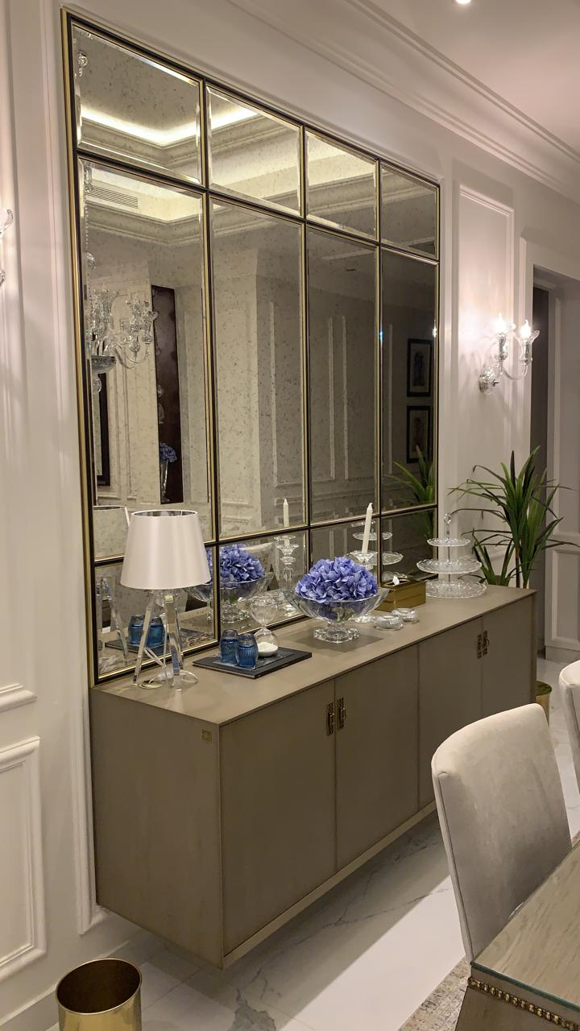
Best Selection For Trading
PROJECT | PROJECT DESCRIPTION
Jeddah Port | Location | Jeddah
 | Year | 2021
 | Scope of Work | Doors / Windows / Vanities
Ford Showroom | Location | Jeddah
 | Year | 2021
 | Scope of Work | Doors / Counters / Vanities / wall Cladding
Dallah Al Barka | Location | Jeddah
 | Year | 2021
 | Scope of Work | Art Frames / Wooden Cabinets / Mirrors
MUVI Cinema | Location | Taif
 | Year | 2021
 | Scope of Work | Seats

Slide 23
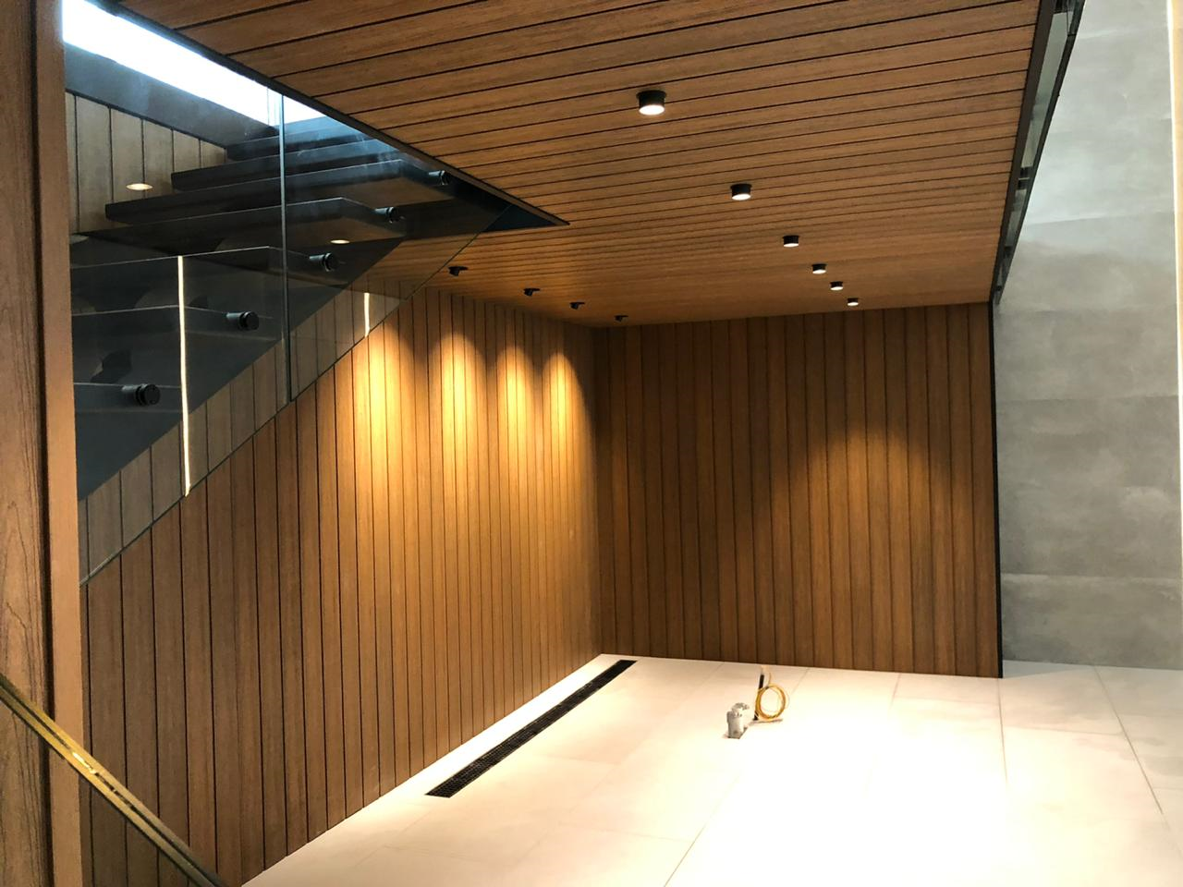
Best Selection For Trading
PROJECT | PROJECT DESCRIPTION
Al Zahid Showroom | Location | Makkah
 | Year | 2021
 | Scope of Work | Doors / Counters / Kitchens / Wall Cladding / Wordrobe / Elc Cabinets/ Offices
MUVI Cinema | Location | Jeddah
 | Year | 2021
 | Scope of Work | Kitchens /Wooden Cabinets
Elip Resturant | Location | Jeddah
 | Year | 2022
 | Scope of Work | Counters / Wooden Tables / Ceiling Works / Seats / Mirrors
Zain Airport | Location | Jeddah
 | Year | 2022
 | Scope of Work | Reception Counter

Slide 24
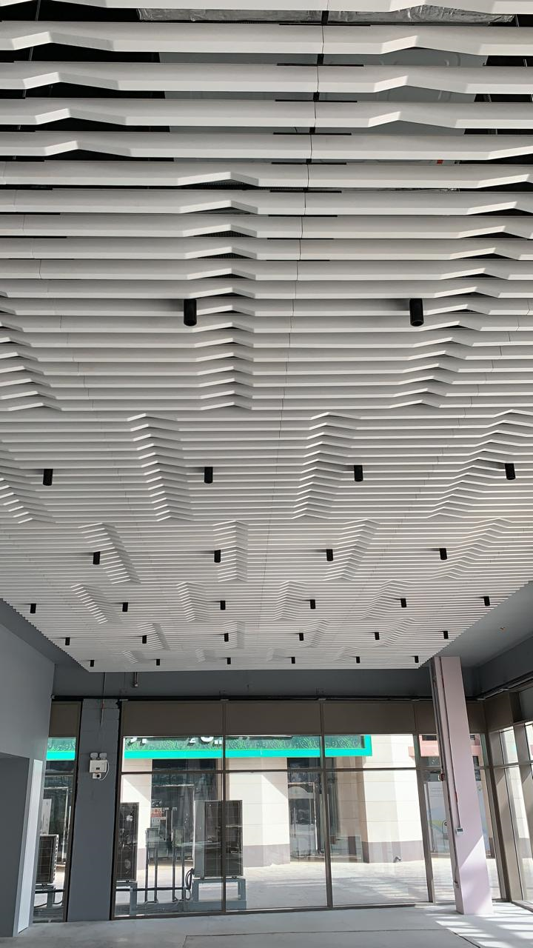
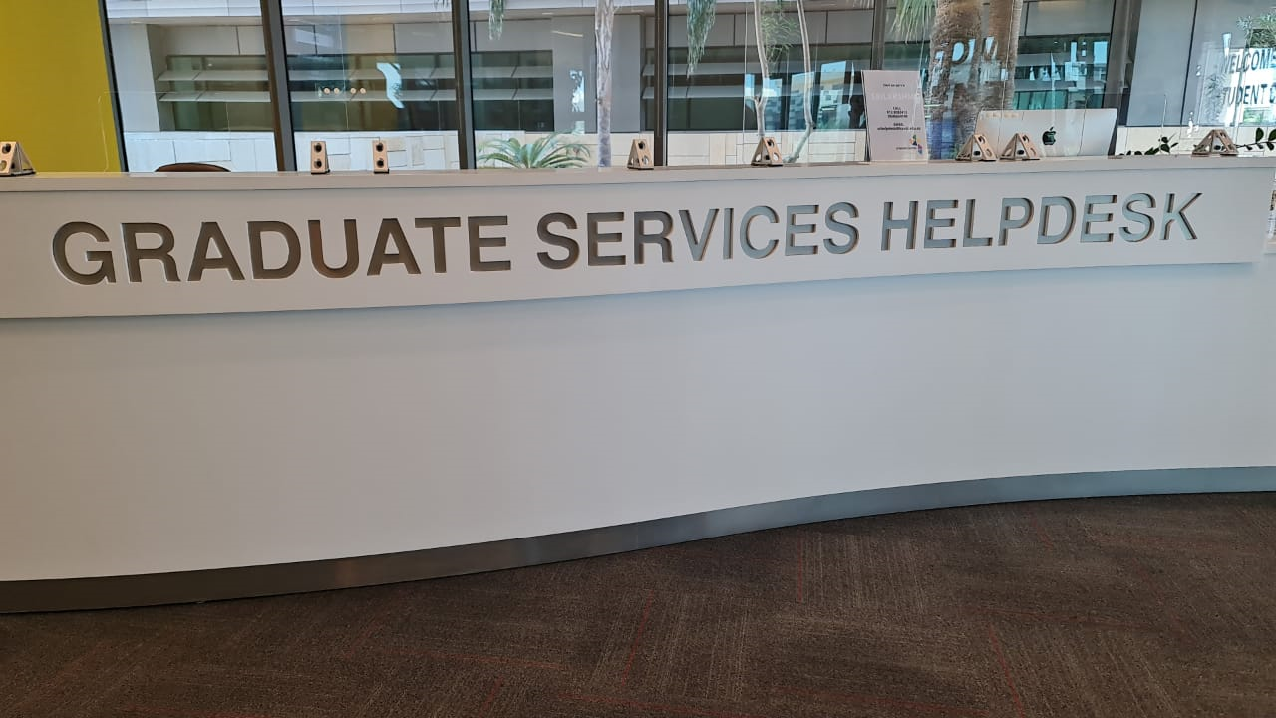
Best Selection For Trading
PROJECT | PROJECT DESCRIPTION
Valantino Showroom | Location | Jeddah
 | Year | 2022
 | Scope of Work | Doors / Kitchen / File Cabinets / Wall Cladding /
Private Offices | Location | Jeddah
 | Year | 2022
 | Scope of Work | Doors Wall Cladding / Offices / Wooden Cabinets
Sprout Resturant | Location | Jeddah
 | Year | 2022
 | Scope of Work | Wooden Ceiling / Wall Cladding / Kitchens / Seats / Windows / Doors / Planet Boxes
Dallah Al Barka | Location | Jeddah
 | Year | 2022
 | Scope of Work | Planet Boxes / Art Frames / Wardrobe / Display Units / Food Trolley

Slide 25
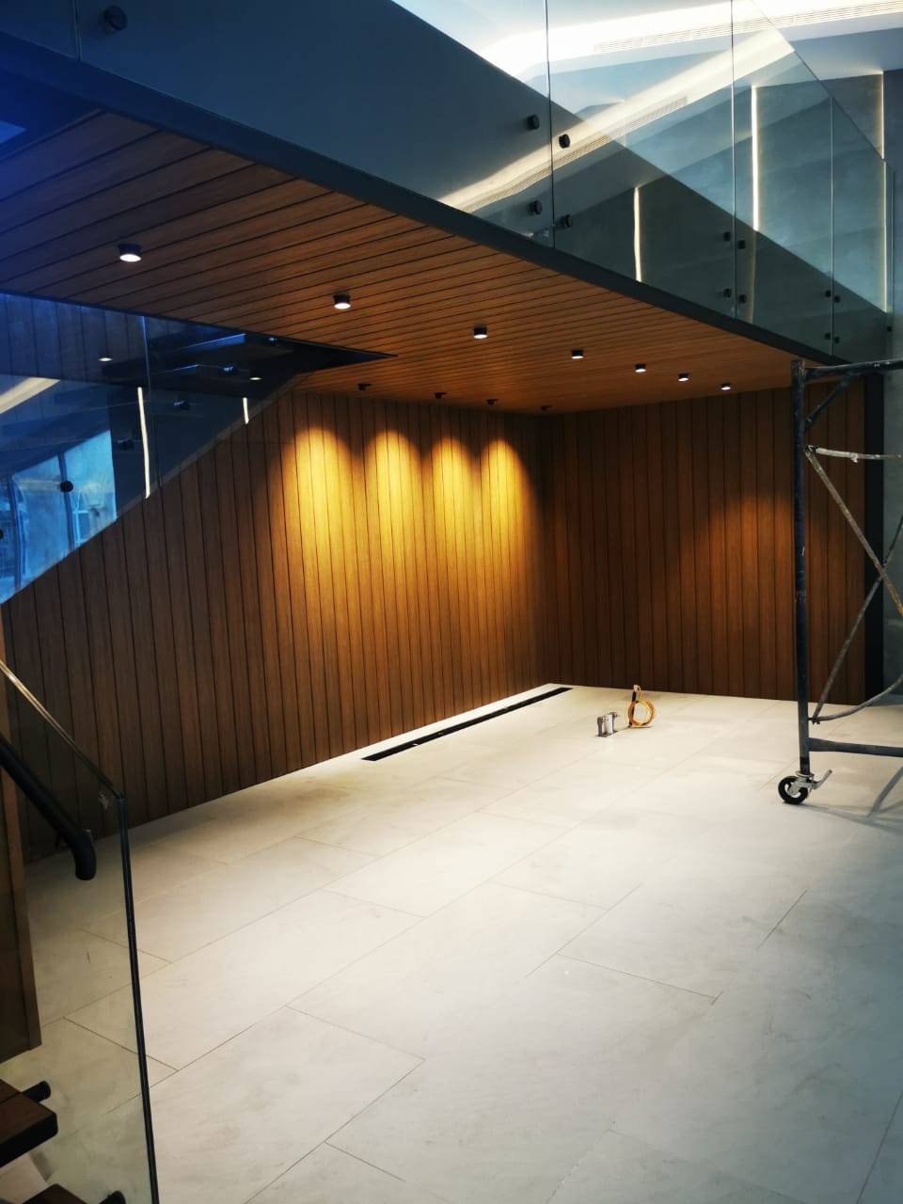
Best Selection For Trading
PROJECT | PROJECT DESCRIPTION
KAEC | Location | Thwal
 | Year | 2022
 | Scope of Work | Doors / Kitchens / Wordrobes /
These projects are an overview of the works that have been implemented in addition to the many diversified projects that have been implemented for major companies and private villas

Slide 26
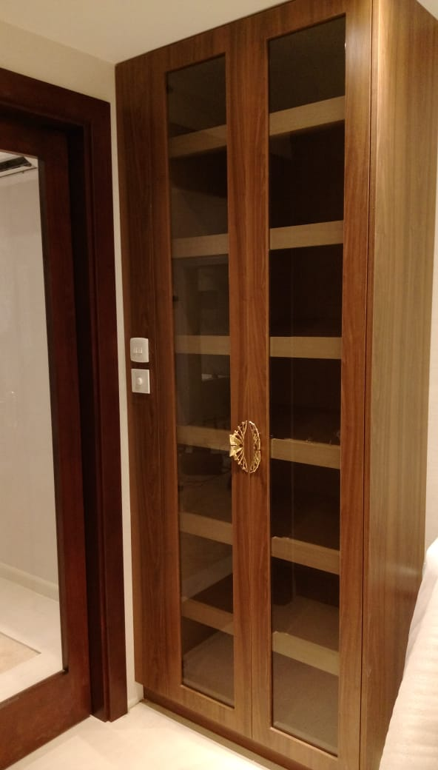
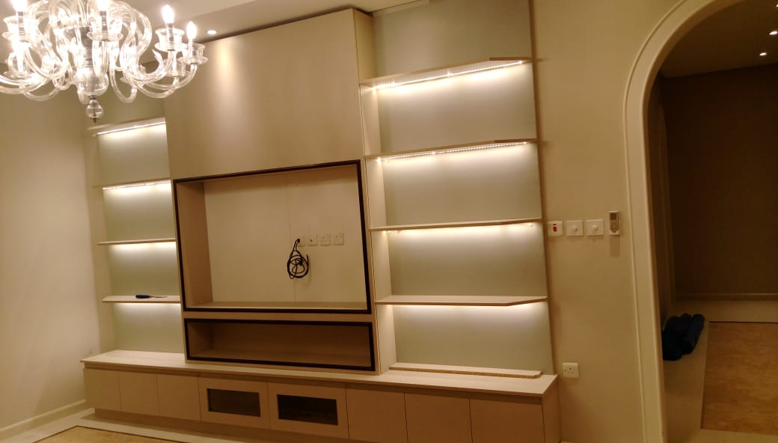
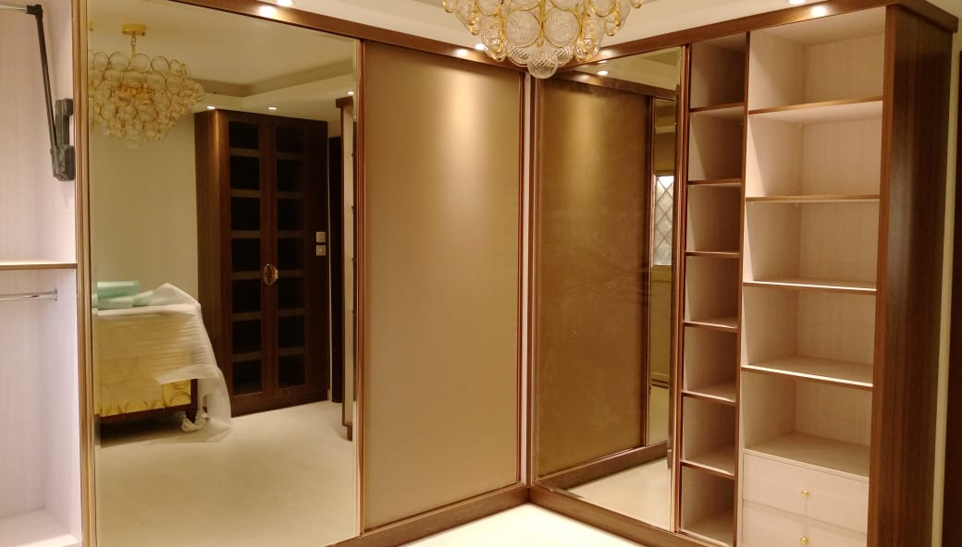
Best Selection For Trading

Slide 27
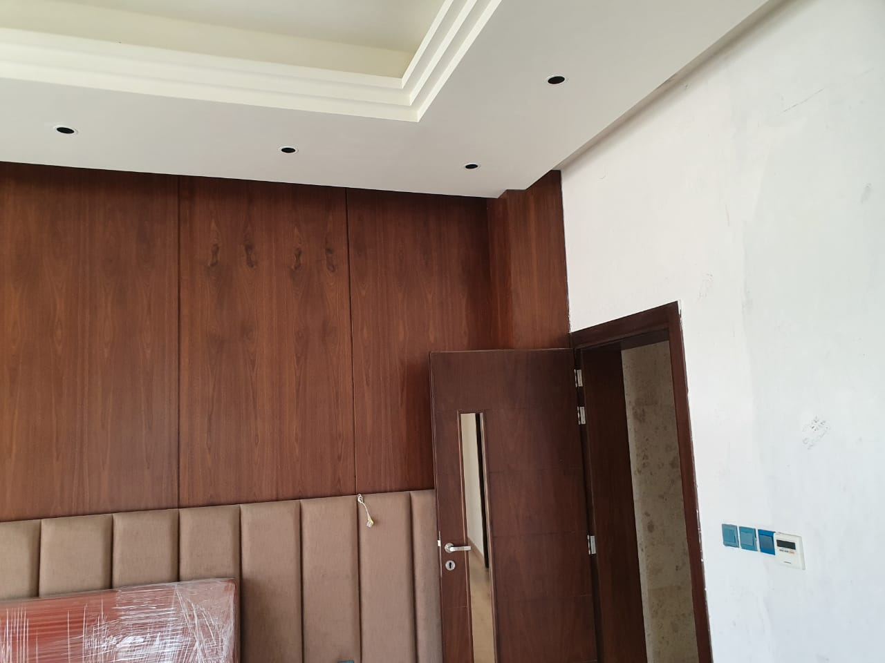
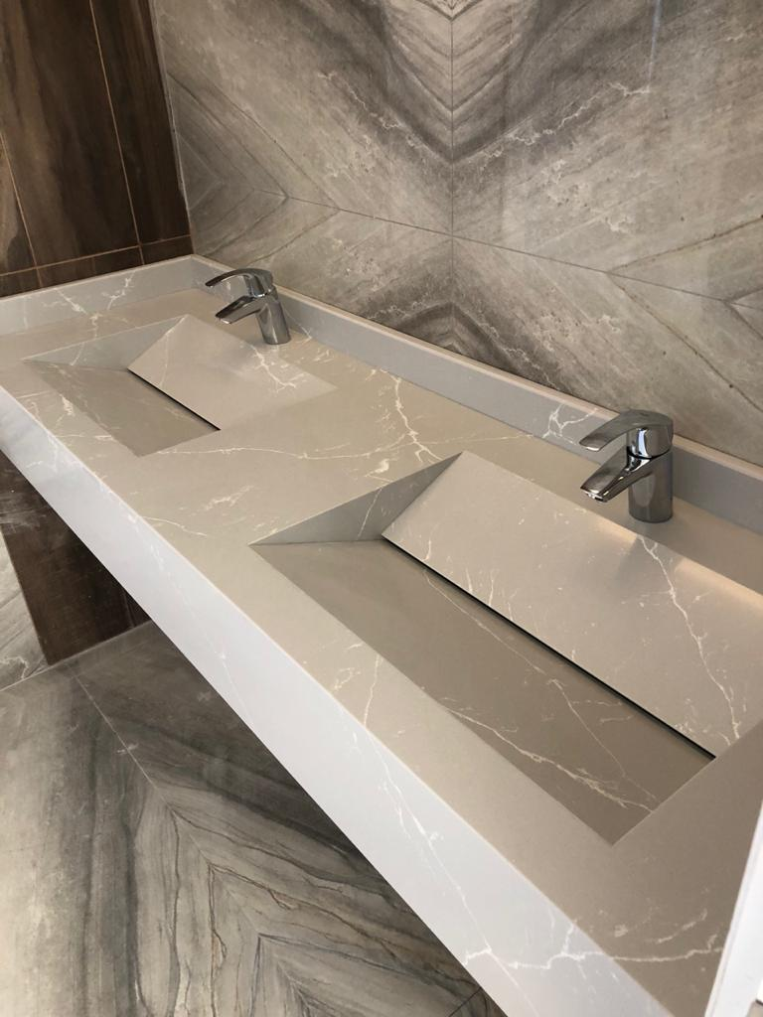
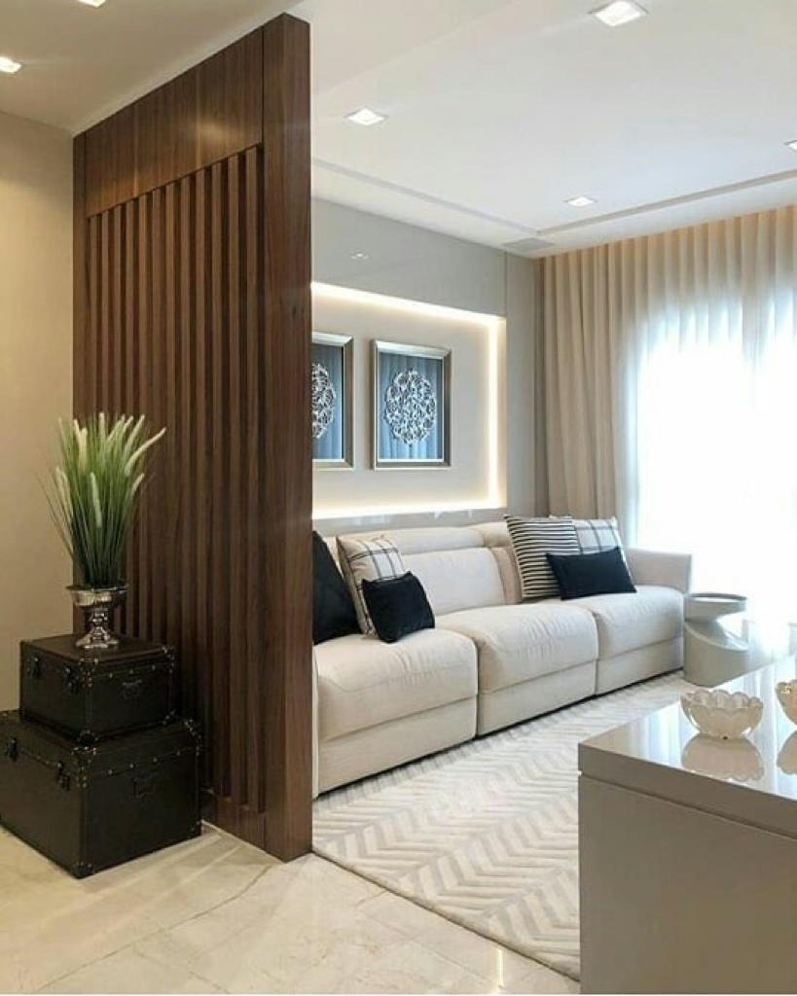
Best Selection For Trading

Slide 28
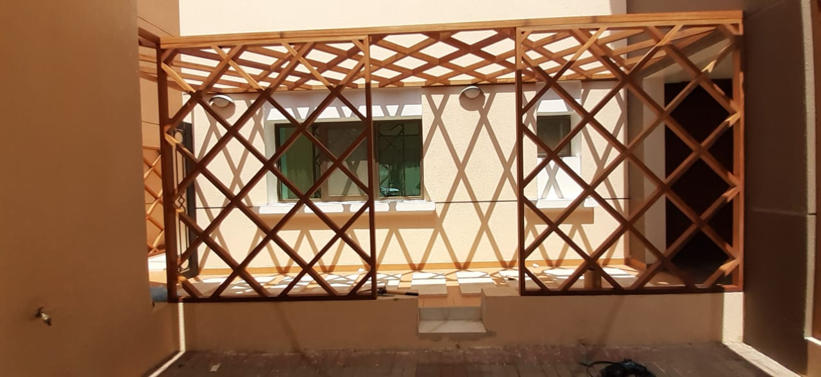
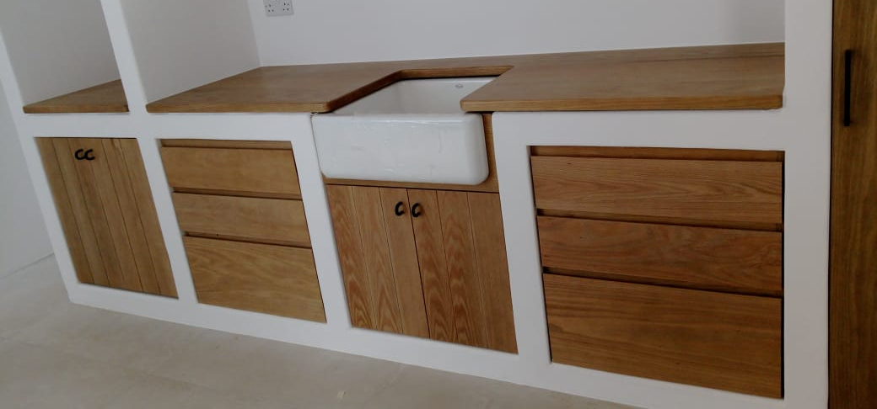
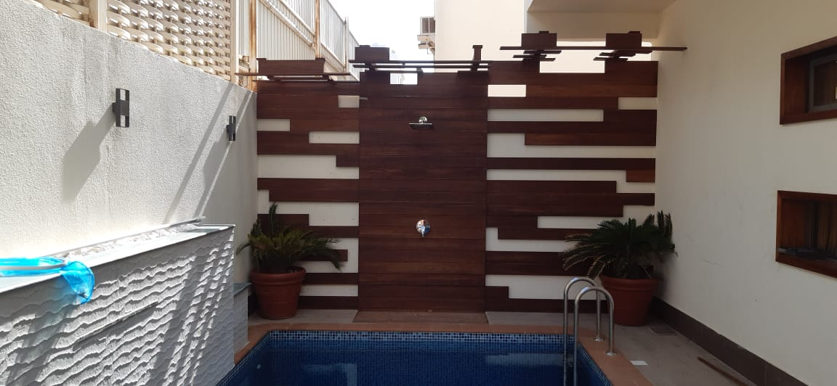
Best Selection For Trading

Slide 29
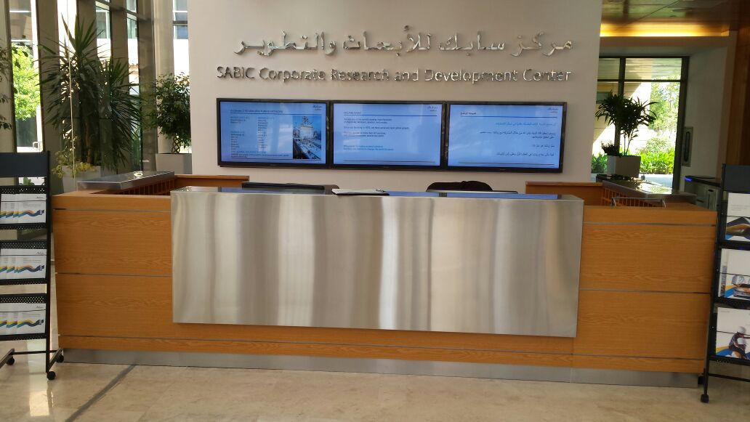
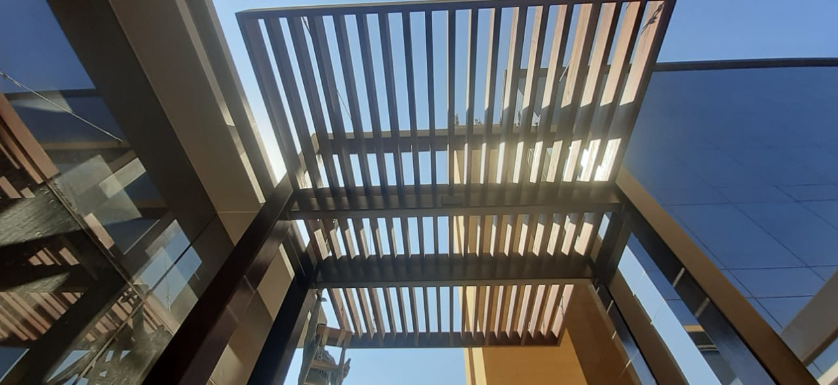
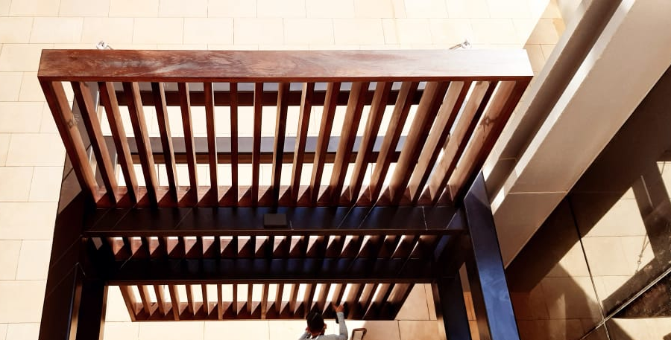
Best Selection For Trading

Slide 30
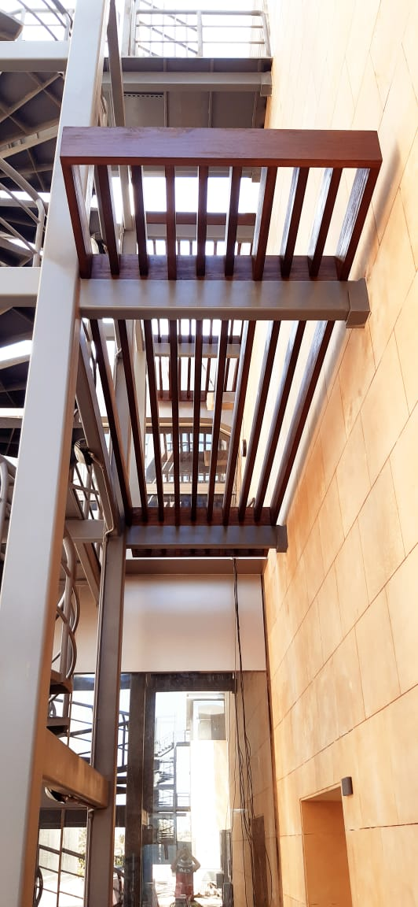
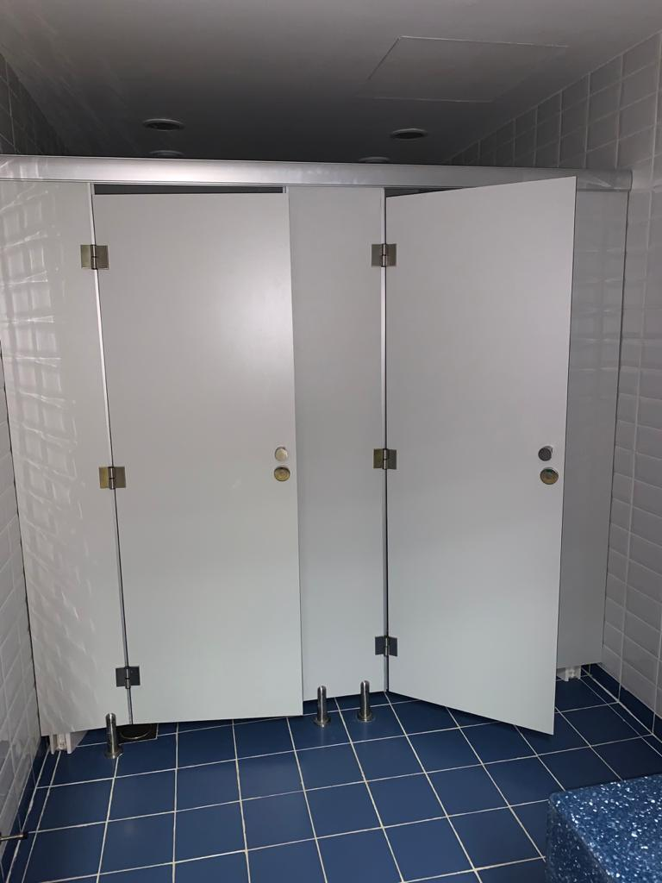
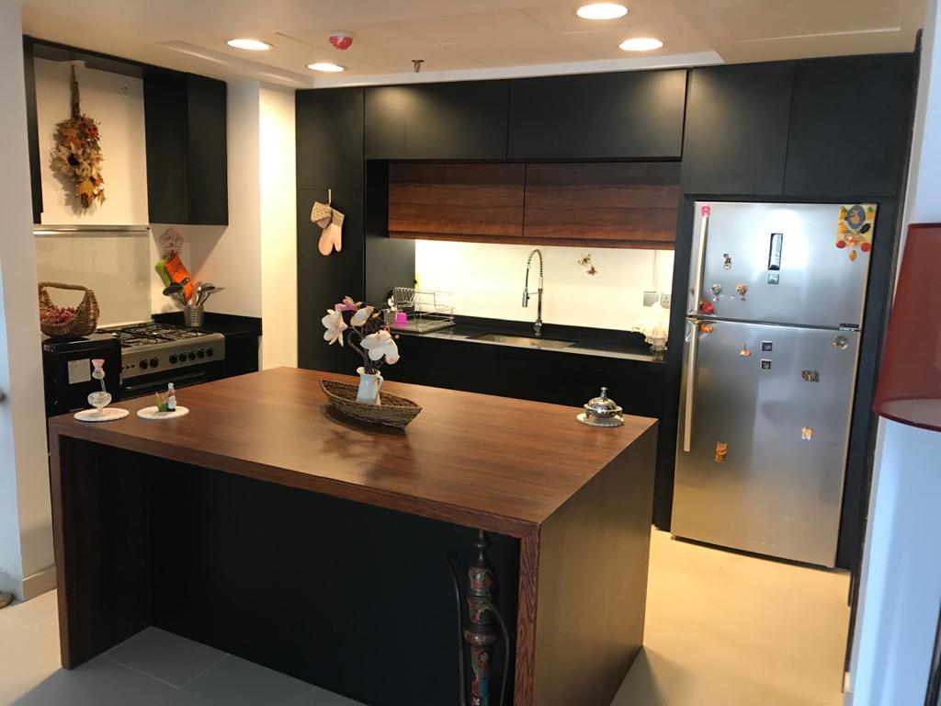
Best Selection For Trading

